Slide 1
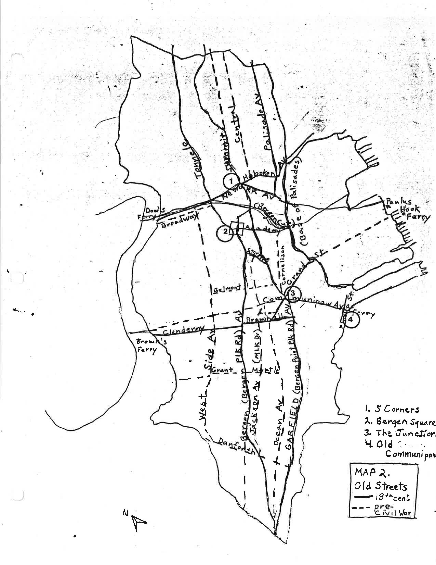
Palisade Avenue

Slide 2
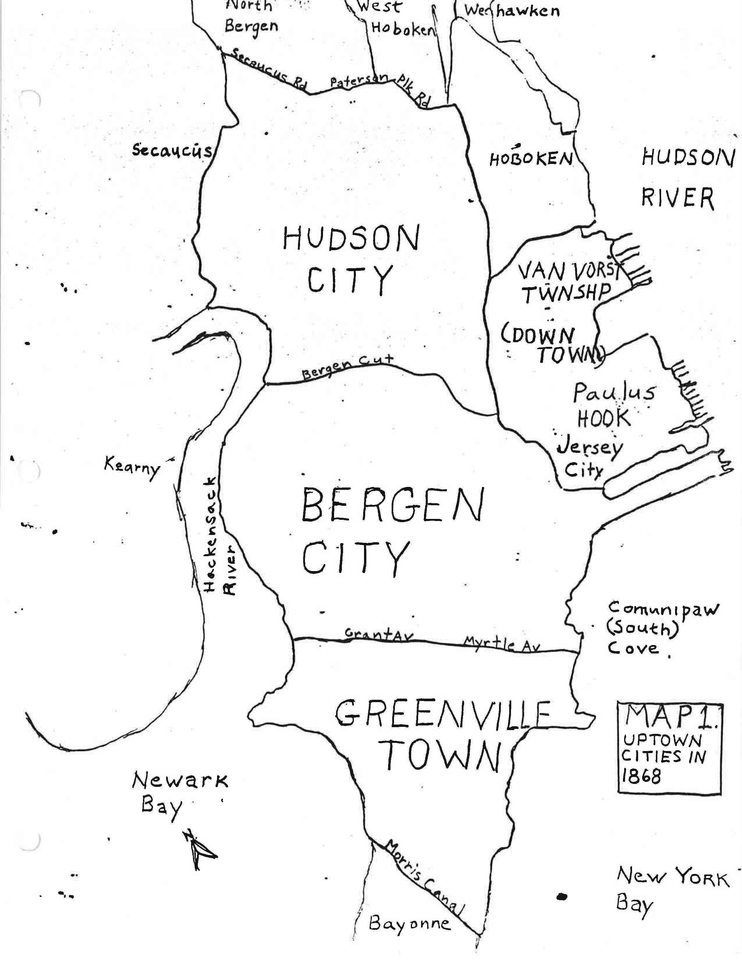
Hudson City

Slide 3
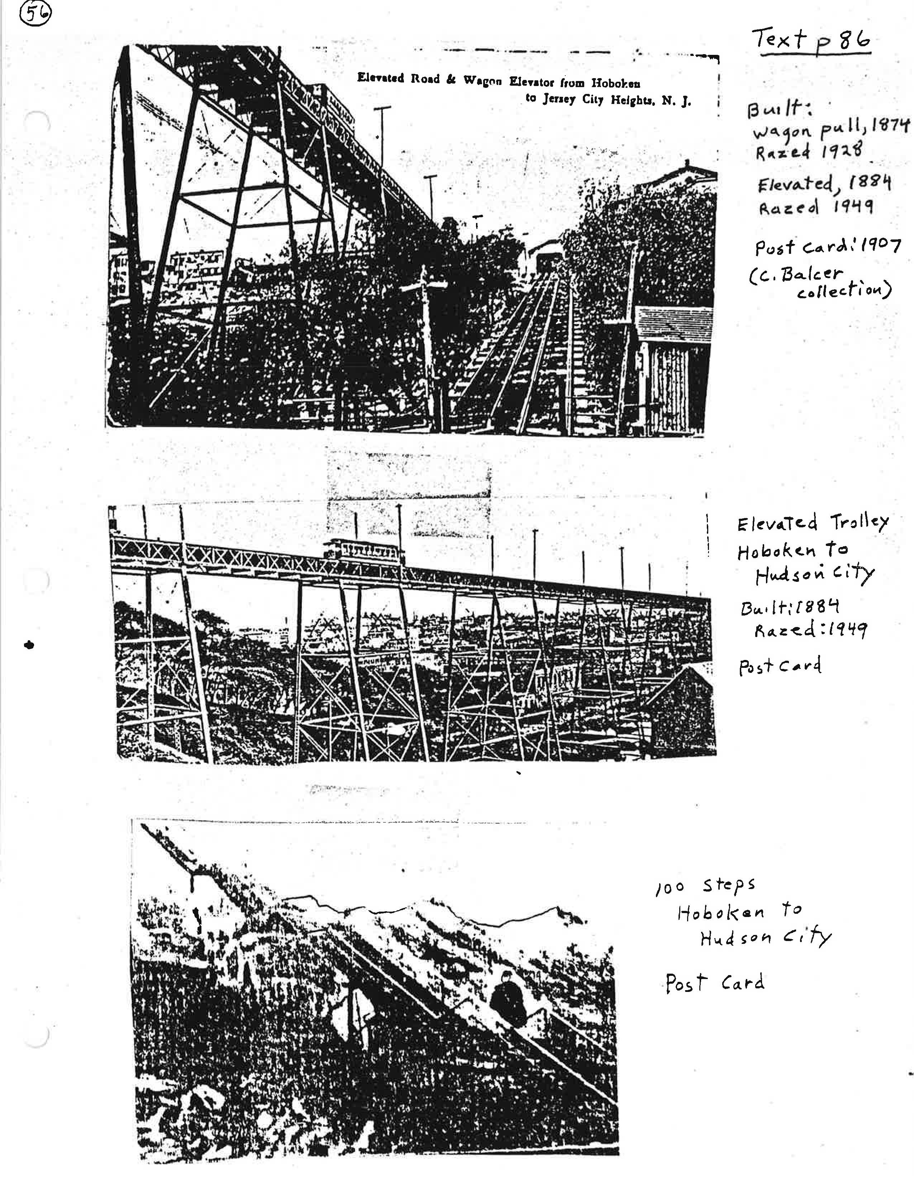
North Hudson Railway Trolley

Slide 4
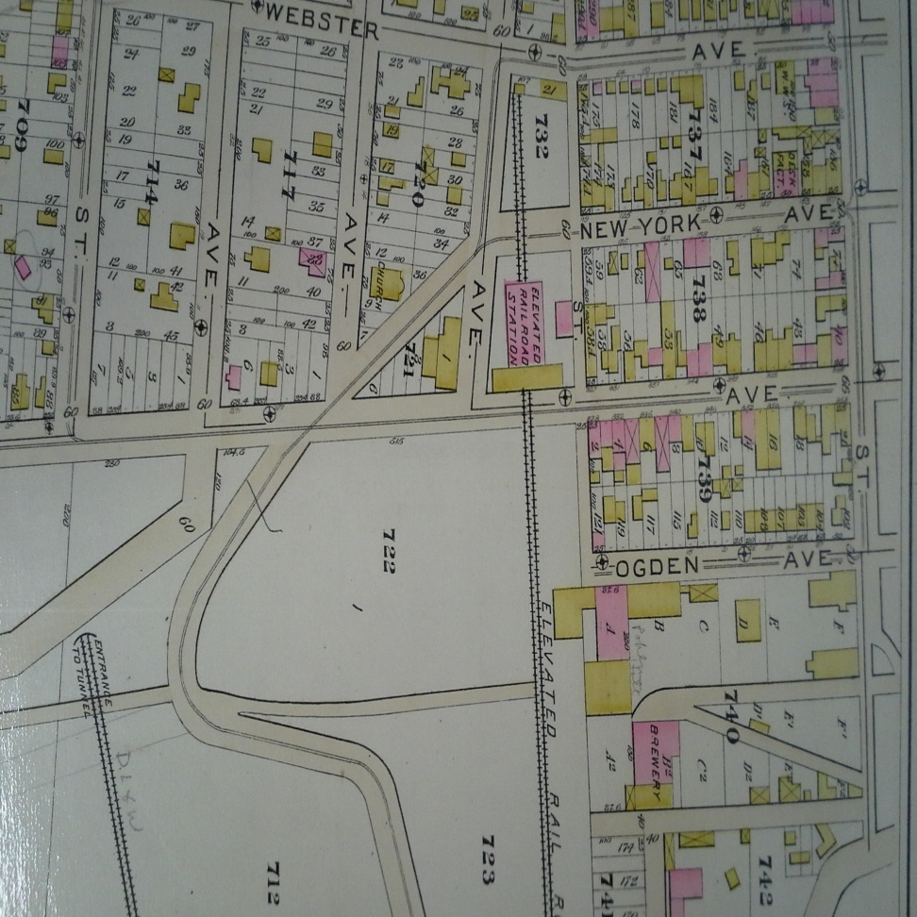
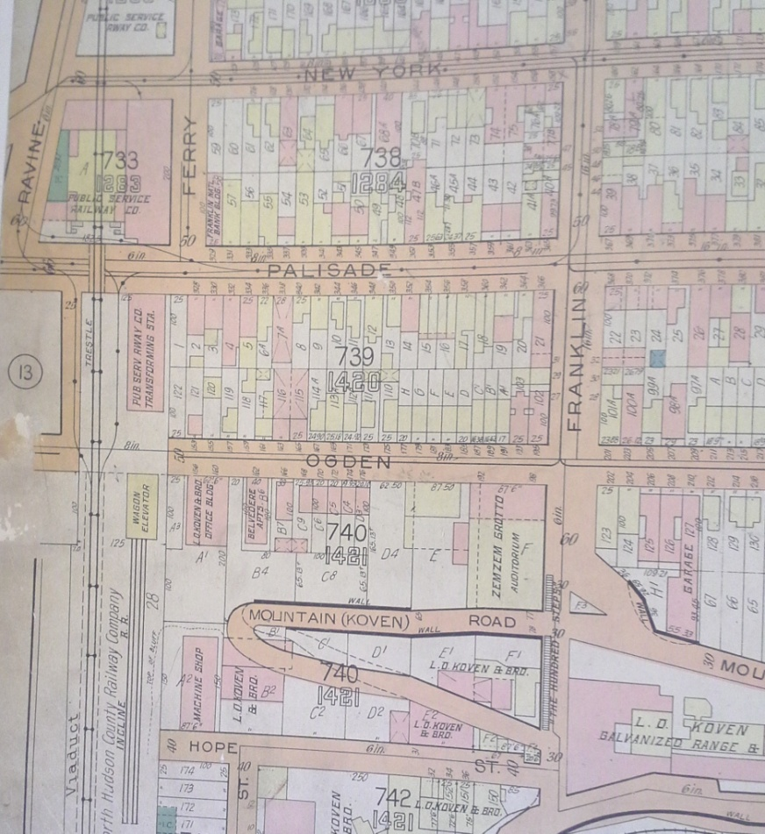
Elevated Trolley
1887
1926

Slide 5
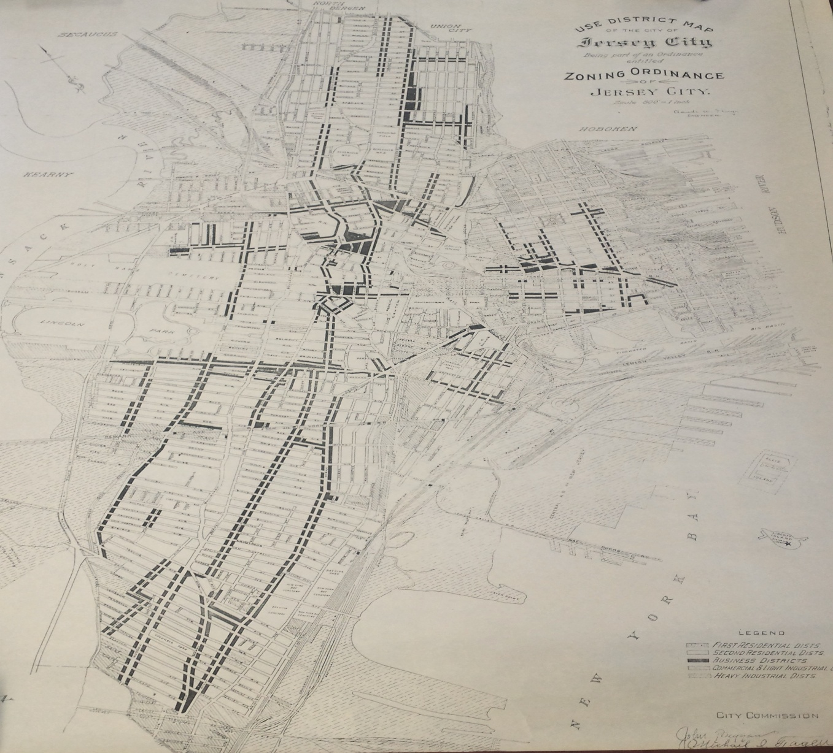
1931 Zoning

Slide 6
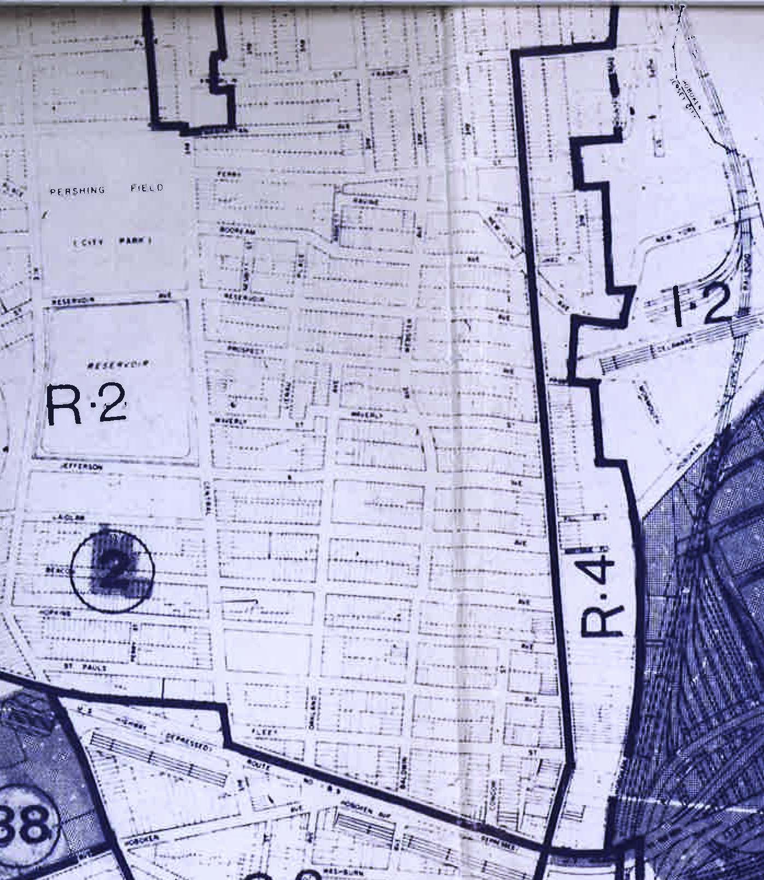
1977 Zoning

Slide 7
“D” Variances
Use d(1)
Density d(5)
Height d(6)
1984 changes to N.J.S.A 55D-70d that all “d” variances are no longer just use variances. Clarifies particular “d” variances and the special reasons that applies to each of them separately.

Slide 8
Special Reasons/Positive Criteria
Refusal to allow the project would impose an undue Hardship on the applicant
When a proposed project carries out the purposes of zoning
  N.J.S. 40:55D-2
Inherently beneficial
  N.J.S. 40:55D-4
***At all times variances must:
- promote the general purposes of zoning,
- general welfare,
- the proposed use is peculiarly fitted to the particular location
- and must be done WITHOUT substantial detriment to the public good or substantially impairing the intent and purpose of the zone plan and zoning ordinance
Use
Ward v. Scott N.J. 117 (1952)
1975 Municipal Land Use Law
Density
Coventry Square Inc. v. Westwood Zoning Board of Adjustment, 138 NJ 1994
Height
Grasso v. Borough of Spring Lake Heights, 375 N.J. Super 41. (2004)

Slide 9
“C” Variances
Minimum Number of Parking Spaces Required
Signage for an awning and hanging blade sign
Parking aisle width
C(1) Hardship from narrowness, shallowness, shape or topographical conditions, or reasons of an extraordinary situation uniquely affecting a specific piece of property
1984 amendment introduces c(2) variances:
The purposes of the Act would be advanced by a deviation from the zoning ordinance requirements and the benefits would outweigh any detriments to the public good

Slide 10
Negative Criteria
No relief may ever be granted unless it can be
done:
Without substantial detriment to the public good.
Without substantially impairing the intent and purpose of the zone plan and zoning ordinance
Medici V. BPR Co., 107 N.J. 1, 4 (1987)

